Slide 1
Artificial Neural Network

Slide 2
Bias
Applications of ANN

Slide 3
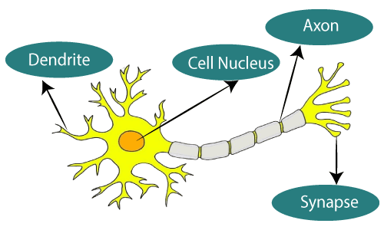
What is Artificial Neural Network?
The term "Artificial Neural Network" is derived from Biological neural networks that develop the structure of a human brain.
Similar to the human brain that has neurons interconnected to one another, artificial neural networks also have neurons that are interconnected to one another in various layers of the networks.
These neurons are known as nodes.
The given figure illustrates the typical diagram of Biological Neural Network.

Slide 4
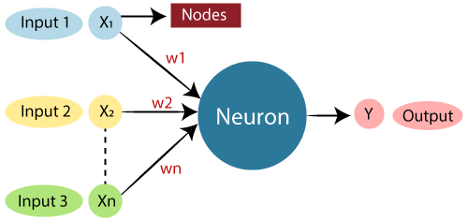
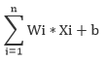
The typical Artificial Neural Network looks something like the given figure.
Dendrites from Biological Neural Network represent inputs in Artificial Neural Networks, cell nucleus represents Nodes, synapse represents Weights, and Axon represents Output.

Slide 5
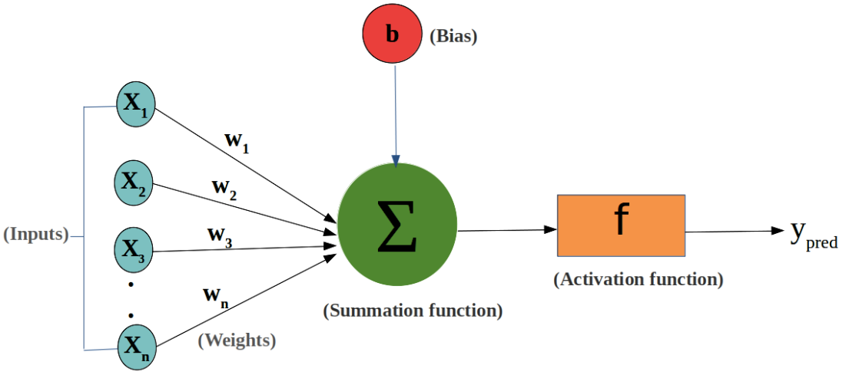
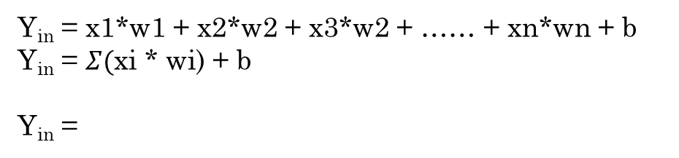
Y_{in}
Y_{in} = x1*w1 + x2*w2 + x3*w2 + …… + xn*wn + b
Y_{in} = $Σ($xi * wi) + b
Y_{in} =
Y_{out}= f(Y_{in} )

Slide 6
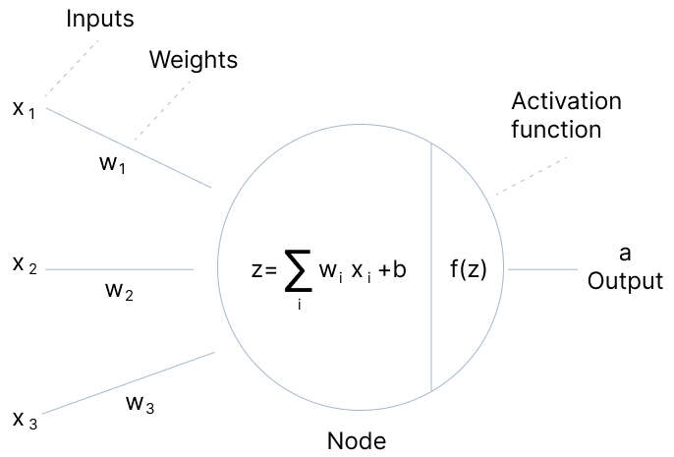

Slide 7
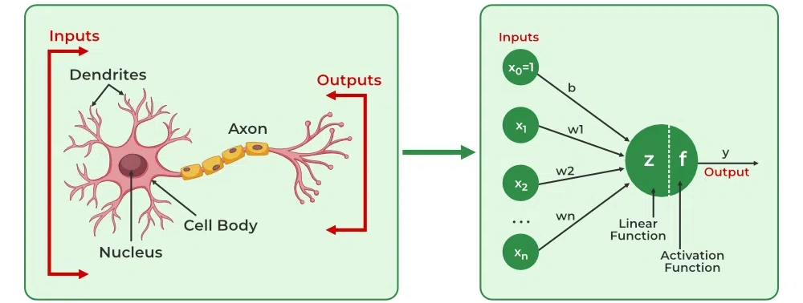
Relationship between Biological neural network and artificial neural network:
Biological Neural Network | Artificial Neural Network
Dendrites | Inputs
Cell nucleus | Nodes
Synapse | Weights
Axon | Output

Slide 8
An Artificial Neural Network in the field of Artificial intelligence where it attempts to mimic the network of neurons makes up a human brain so that computers will have an option to understand things and make decisions in a human-like manner.
The artificial neural network is designed by programming computers to behave simply like interconnected brain cells.
There are around 1000 billion neurons in the human brain. Each neuron has an association point somewhere in the range of 1,000 and 100,000.
In the human brain, data is stored in such a manner as to be distributed, and we can extract more than one piece of this data when necessary from our memory parallelly. We can say that the human brain is made up of incredibly amazing parallel processors.

Slide 9
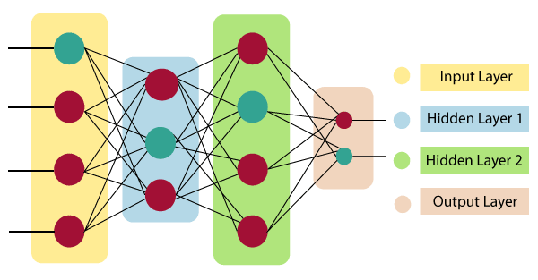
The architecture of an artificial neural network:
To understand the concept of the architecture of an artificial neural network, we have to understand what a neural network consists of. In order to define a neural network that consists of a large number of artificial neurons, which are termed units arranged in a sequence of layers. Lets us look at various types of layers available in an artificial neural network.
Artificial Neural Network primarily consists of three layers:
Input Layer:
As the name suggests, it accepts inputs in several different formats provided by the programmer.
Hidden Layer:
The hidden layer presents in-between input and output layers. It performs all the calculations to find hidden features and patterns.
Output Layer:
The input goes through a series of transformations using the hidden layer, which finally results in output that is conveyed using this layer.
The artificial neural network takes input and computes the weighted sum of the inputs and includes a bias. This computation is represented in the form of a transfer function.
It determines weighted total is passed as an input to an activation function to produce the output. Activation functions choose whether a node should fire or not. Only those who are fired make it to the output layer. There are distinctive activation functions available that can be applied upon the sort of task we are performing.

Slide 10
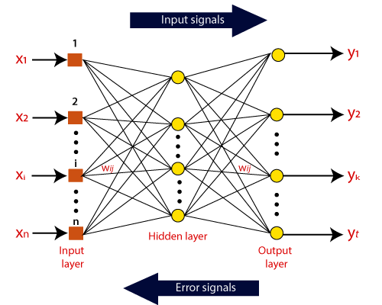
How do artificial neural networks work?
Artificial Neural Network can be best represented as a weighted directed graph, where the artificial neurons form the nodes. The association between the neurons outputs and neuron inputs can be viewed as the directed edges with weights. The Artificial Neural Network receives the input signal from the external source in the form of a pattern and image in the form of a vector. These inputs are then mathematically assigned by the notations x(n) for every n number of inputs.

Slide 11
Afterward, each of the input is multiplied by its corresponding weights ( these weights are the details utilized by the artificial neural networks to solve a specific problem ). In general terms, these weights normally represent the strength of the interconnection between neurons inside the artificial neural network. All the weighted inputs are summarized inside the computing unit.
If the weighted sum is equal to zero, then bias is added to make the output non-zero or something else to scale up to the system's response. Bias has the same input, and weight equals to 1. Here the total of weighted inputs can be in the range of 0 to positive infinity. Here, to keep the response in the limits of the desired value, a certain maximum value is benchmarked, and the total of weighted inputs is passed through the activation function.
What are the types of Artificial Neural Networks?
Feedforward Neural Network
Single layer
Multi layer
Convolutional Neural Network
Modular Neural Network
Radial basis function Neural Network
Recurrent Neural Network

Slide 12
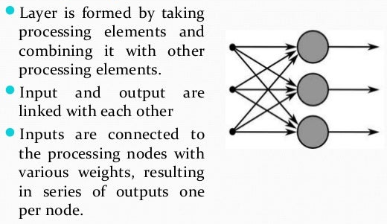
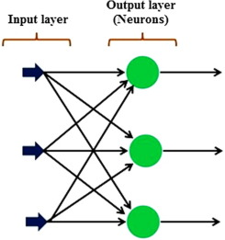
Feedforward network:
The advancement of layered feed-forward networks initiated in the late 1950s, given by Rosenblatt's perceptron and Widrow's Adaptive linear Element (ADLINE).
Single-layer feedforward network[SFFN]
Rosenblatt first constructed the single-layer feedforward network in the late 1950s and early 1990s. The concept of feedforward artificial neural network having just one weighted layer. In other words, we can say that the input layer is completely associated with the outer layer.

Slide 13
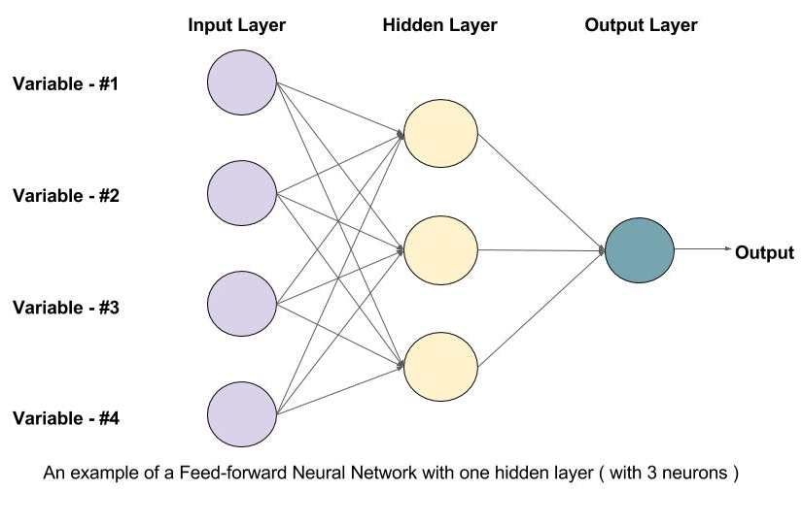
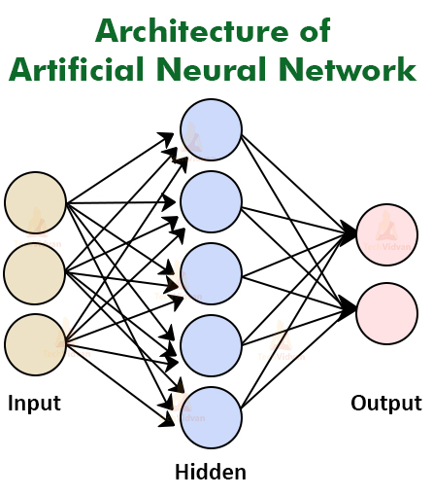
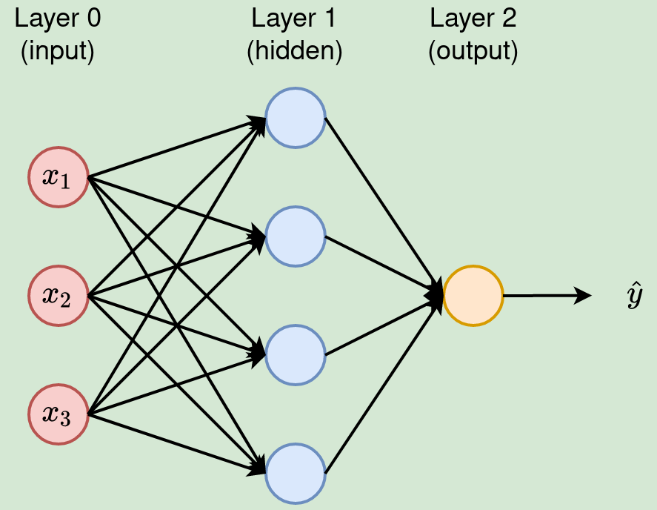
Multilayer feedforward network [MFFN]
A multilayer feedforward neural network is a linkage of perceptron in which information and calculations flow are uni-directional, from the input data to the outputs.
The total number of layers in a neural network is the same as the total number of layers of perceptron.
The easiest neural network is one with a single input layer and an output layer of perceptron.
The concept of feedforward artificial neural network having more than one weighted layer. As the system has at least one layer between the input and the output layer, it is called the hidden layer.

Slide 14
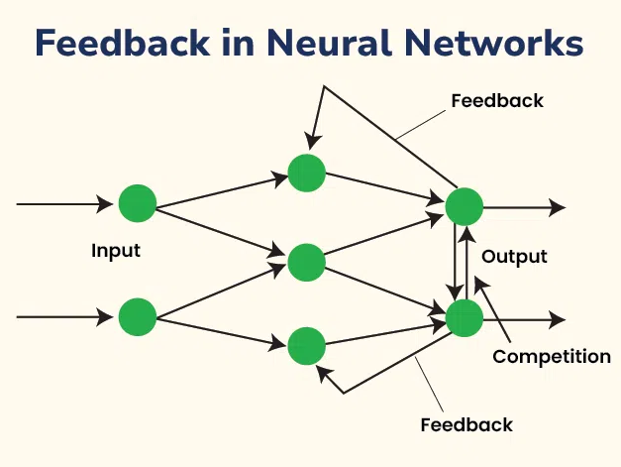
Feedback Neural Networks (RNNs): These networks have connections that loop back, allowing information to be fed back into the network. This structure enables them to handle sequential data and temporal dependencies, making them suitable for tasks like time series prediction and language modeling.
Structure of Feedback Neural Networks
Feedback neural networks, or RNNs, are characterized by their ability to maintain a state that captures information about previous inputs. This is achieved through recurrent connections that loop back from the output to the input of the same layer or previous layers. The key components of an RNN include:
Input Layer: Receives the input data.
Hidden Layers: Contain neurons with recurrent connections that maintain a state over time.
Output Layer: Produces the final output based on the processed information.

Slide 15
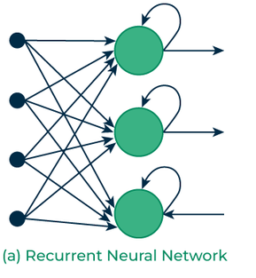
Types of Feedback Neural Networks (RNNs):
Recurrent network:
The human brain is a recurrent neural network that refers to a network of neurons with feedback connections.
It can learn numerous behaviors, sequence, processing tasks algorithms, and programs that are not learnable by conventional learning techniques.
It explains the rapidly growing interest in artificial recurrent networks for technical applications.
For example, general computers that can learn algorithms to map input arrangements to output arrangements, with or without an instructor. They are computationally more dominant and biologically more conceivable than other adaptive methodologies.
For example, Hidden Markov models (no continuous internal states), feedforward networks, and supportive vector machines (no internal states).

Slide 16
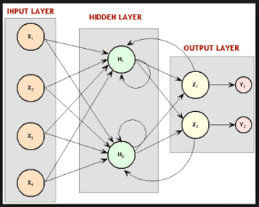
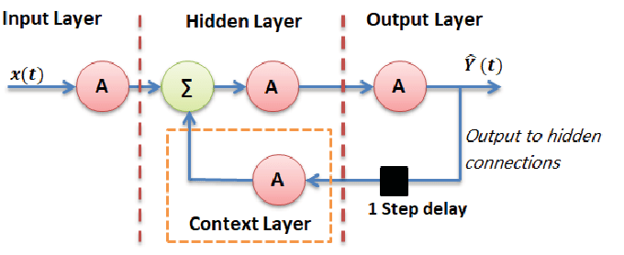
Fully recurrent network:
The most straightforward form of a fully recurrent neural network is a Multi-Layer Perceptron (MLP) with the previous set of hidden unit activations, feeding back along with the inputs.
In other words, it is the easiest neural network design because all nodes are associated with all other nodes with every single node work as both input and output.
Jordan network:
The Jordan network refers to a simple neural structure in which only one value of the process input signal (from the previous sampling) and only one value of the delayed output signal of the model (from the previous sampling) are utilized as the inputs of the network.
In order to get a computationally basic MPC (Model Predictive Control) algorithm, the nonlinear Jordan neural model is repeatedly linearized on line around an operating point, which prompts a quadratic optimization issue.
Adequacy of the described MPC algorithm is compared with that of the nonlinear MPC scheme with on-line nonlinear optimization performed at each sampling instant.

Slide 17
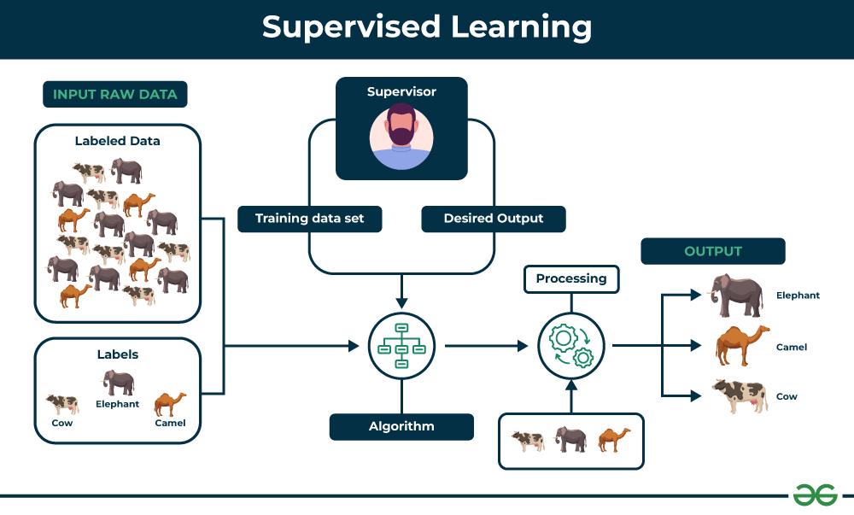
Adjustments of Weights or Learning:
Learning in ANN is the technique for changing the weights of associations between the neurons of a specified network. Learning in artificial neural networks can be characterized into three different categories, namely supervised learning, unsupervised learning, and reinforcement learning.
Supervised learning:
Supervised learning consists of two words supervised and learning. Supervise intends to guide. We have supervisors whose duty is to guide and show the way. We can see a similar case in the case of learning. Here the machine or program is learning with the help of the existing data set. We have a data set, and we assume the results of new data relying upon the behavior of the existing data sets. It implies the existing data sets acts as a supervisor or boss to find the new data. A basic example being electronic gadgets price prediction. The price of electronic gadgets is predicted depending on what is observed with the prices of other digital gadgets.
During the training of artificial neural networks under supervised learning, the input vector is given to the network, which offers an output vector. Afterward, the output vector is compared with the desired output vector. An error signal is produced if there is a difference between the actual output and the desired output vector. Based on this error signal, the weight is adjusted until the actual output is matched with the desired output.

Slide 18
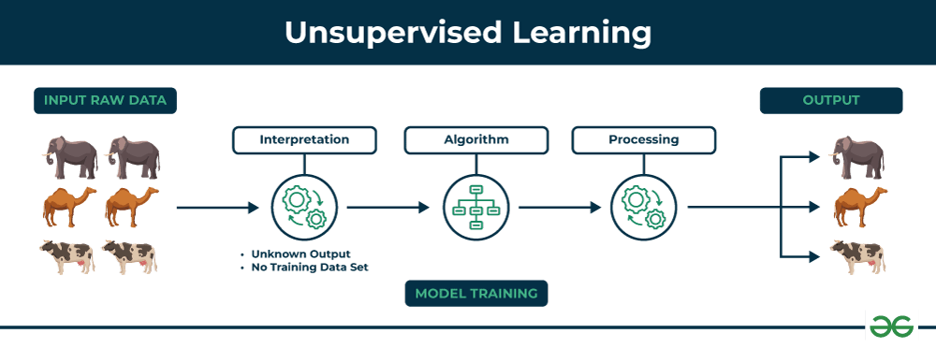
Unsupervised learning:
As the name suggests, unsupervised learning refers to predict something without any supervision or help from existing data. In this learning, the program learns by dividing the data with similar characteristics into similar groups. In supervised learning, the data are grouped, relying upon similar characteristics. In this situation, there are no existing data to look for direction. In other words, there is no supervisor. During the training of the artificial neural network under unsupervised learning, the input vectors of a comparative type are joined to form clusters. At the point when a new input pattern is implemented, then the neural network gives an output response showing the class to which the input pattern belongs. There is no feedback from the environment about what should be the ideal output and if it is either correct or incorrect. Consequently, in this type of learning, the network itself must find the patterns and features from the input data and the connection for the input data over the output.

Slide 19
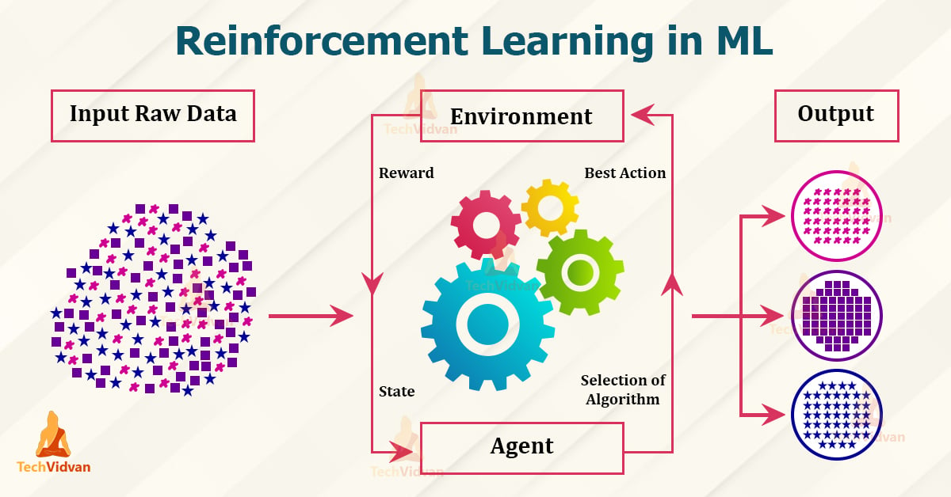
Reinforcement learning:
Reinforcement Learning (RL) is a technique that helps to solve control optimization issues. By using control optimization, we can recognize the best action in each state visited by the system in order to optimize some objective function. Typically, reinforcement learning comes into existence when the system has a huge number of states and has a complex stochastic structure, which is not responsible to closed-form analysis. If issues have a relatively small number of states, then the random structure is relatively simple, so that one can utilize dynamic programming.

Slide 20
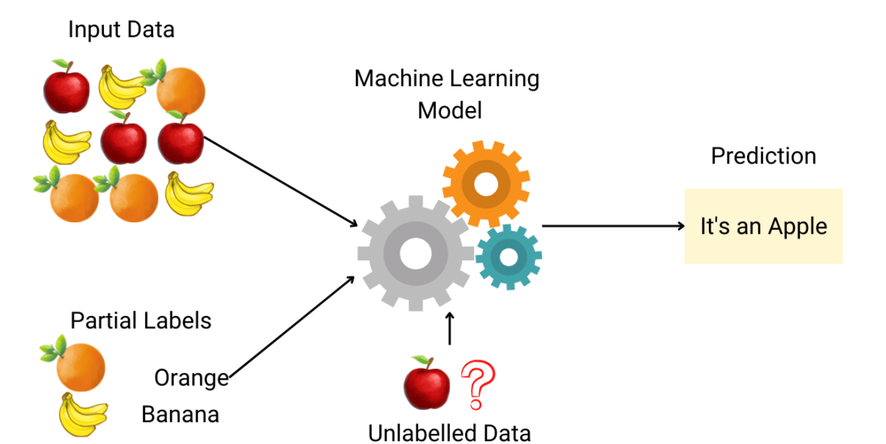
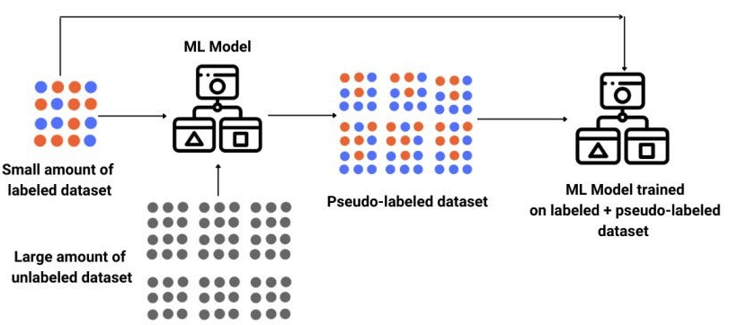
Semi-Supervised Learning in ML
Semi-supervised learning is a type of machine learning that falls in between supervised and unsupervised learning. It is a method that uses a small amount of labeled data and a large amount of unlabeled data to train a model. The goal of semi-supervised learning is to learn a function that can accurately predict the output variable based on the input variables, similar to supervised learning. However, unlike supervised learning, the algorithm is trained on a dataset that contains both labeled and unlabeled data.
Semi-supervised learning is particularly useful when there is a large amount of unlabeled data available, but it’s too expensive or difficult to label all of it.

Slide 21
Criteria | ﻿Supervised Learning | Unsupervised Learning | Reinforcement Learning
Input Data | Input data is labelled. | Input data is not labelled. | Input data is not predefined.
Problem | Learn pattern of inputs and their labels. | Divide data into classes. | Find the best reward between a start and an end state.
Solution | Finds a mapping equation on input data and its labels. | Finds similar features in input data to classify it into classes. | Maximizes reward by assessing the results of state-action pairs
Model Building | Model is built and trained prior to testing. | Model is built and trained prior to testing. | The model is trained and tested simultaneously.
Applications | Deal with regression and classification problems. | Deals with clustering and associative rule mining problems. | Deals with exploration and exploitation problems.
Algorithms Used | Decision trees, linear regression, K-nearest neighbors | K-means clustering, k-medoids clustering, agglomerative clustering | Q-learning, SARSA, Deep Q Network
Examples | Image detection, Population growth prediction | Customer segmentation, feature elicitation, targeted marketing, etc | Drive-less cars, self-navigating vacuum cleaners, etc

Slide 22
Activation functions in Neural Networks
It is recommended to understand Neural Networks before reading this article.
In the process of building a neural network, one of the choices you get to make is what Activation Function to use in the hidden layer as well as at the output layer of the network. This article discusses some of the choices.
Elements of a Neural Network
Input Layer: This layer accepts input features. It provides information from the outside world to the network, no computation is performed at this layer, nodes here just pass on the information(features) to the hidden layer.
Hidden Layer: Nodes of this layer are not exposed to the outer world, they are part of the abstraction provided by any neural network. The hidden layer performs all sorts of computation on the features entered through the input layer and transfers the result to the output layer.
Output Layer: This layer bring up the information learned by the network to the outer world.
What is an activation function and why use them?
The activation function decides whether a neuron should be activated or not by calculating the weighted sum and further adding bias to it. The purpose of the activation function is to introduce non-linearity into the output of a neuron.
Explanation: We know, the neural network has neurons that work in correspondence with weight, bias, and their respective activation function. In a neural network, we would update the weights and biases of the neurons on the basis of the error at the output. This process is known as back-propagation. Activation functions make the back-propagation possible since the gradients are supplied along with the error to update the weights and biases.

Slide 23
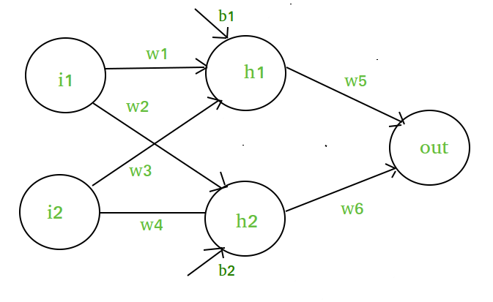
Why do we need Non-linear activation function?
A neural network without an activation function is essentially just a linear regression model. The activation function does the non-linear transformation to the input making it capable to learn and perform more complex tasks.
Mathematical proof
Suppose we have a Neural net like this :-
Elements of the diagram are as follows:
Hidden layer i.e. layer 1:
z(1) = W(1)X + b(1) a(1)
Here,
z(1) is the vectorized output of layer 1
W(1) be the vectorized weights assigned to neurons of hidden layer i.e. w1, w2, w3 and w4
X be the vectorized input features i.e. i1 and i2
b is the vectorized bias assigned to neurons in hidden layer i.e. b1 and b2
a(1) is the vectorized form of any linear function.

Slide 24
This observation results again in a linear function even after applying a hidden layer, hence we can conclude that, doesn’t matter how many hidden layer we attach in neural net, all layers will behave same way because the composition of two linear function is a linear function itself. Neuron can not learn with just a linear function attached to it. A non-linear activation function will let it learn as per the difference w.r.t error. Hence we need an activation function.
Layer 2 i.e. output layer :-
Note : Input for layer 2 is output from layer 1
z(2) = W(2)a(1) + b(2)
a(2) = z(2)
Calculation at Output layer
z(2) = (W(2) * [W(1)X + b(1)]) + b(2)
z(2) = [W(2) * W(1)] * X + [W(2)*b(1) + b(2)]
Let,
[W(2) * W(1)] = W
[W(2)*b(1) + b(2)] = b
Final output : z(2) = W*X + b
which is again a linear function

Slide 25
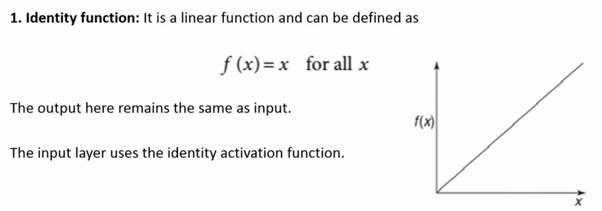
Activation Function:
Activation functions refer to the functions used in neural networks to compute the weighted sum of input and biases, which is used to choose the neuron that can be fire or not. It controls the presented information through some gradient processing, normally gradient descent. It produces an output for the neural network that includes the parameters in the data.Activation function can either be linear or non-linear, relying on the function it shows. It is used to control the output of outer neural networks across various areas, such as speech recognition, segmentation, fingerprint detection, cancer detection system, etc.
Linear Activation Function:
The equation of the linear activation function is the same as the equation of a straight line i.e.
Y= MX+ C
If we have many layers and all the layers are linear in nature, then the final activation function of the last layer is the same as the linear function of the first layer. The range of a linear function is –infinitive to + infinitive.
Linear activation function can be used at only one place that is the output layer.

Slide 26
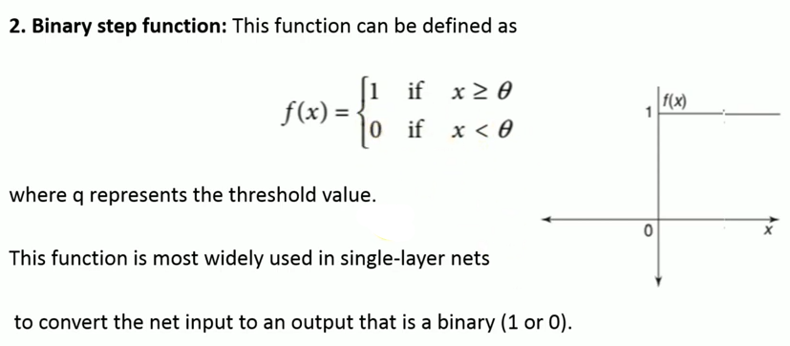
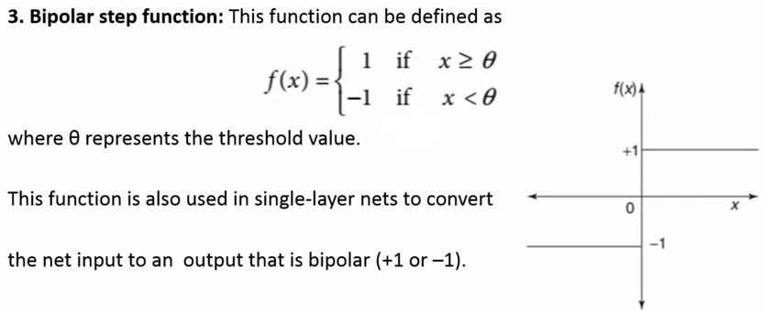
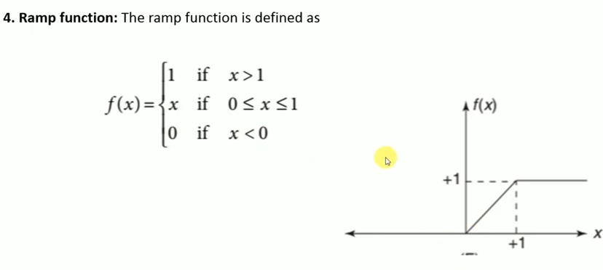
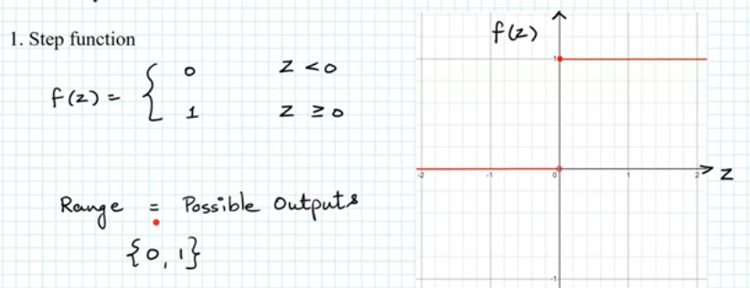

Slide 27
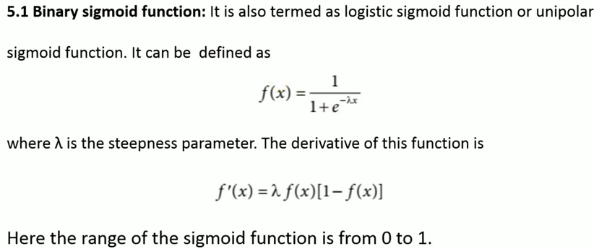
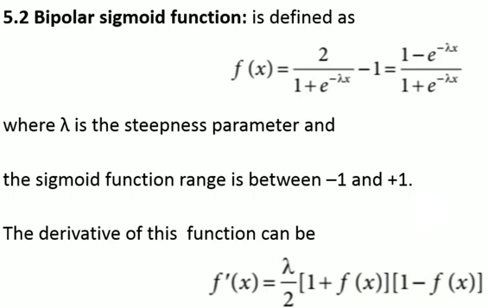

Sigmoid function:
Sigmoid function refers to a function that is projected as S - shaped graph.
A = 1/(1+e^{-x})
This function is non-linear, and the values of x lie between -2 to +2. So that the value of X is directly proportional to the values of Y. It means a slight change in the value of x would also bring about changes in the value of y.

Slide 28
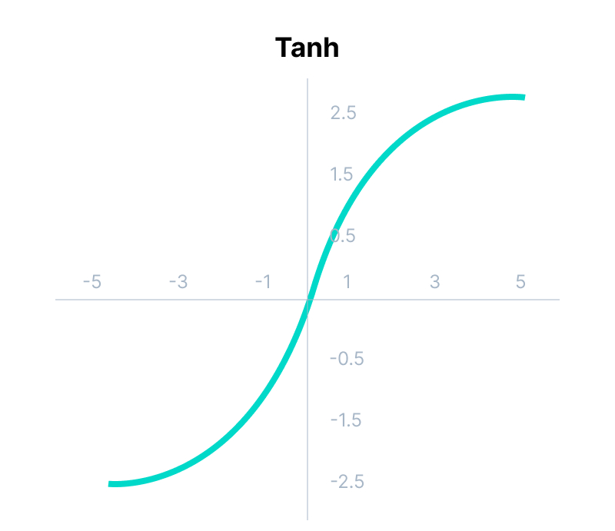
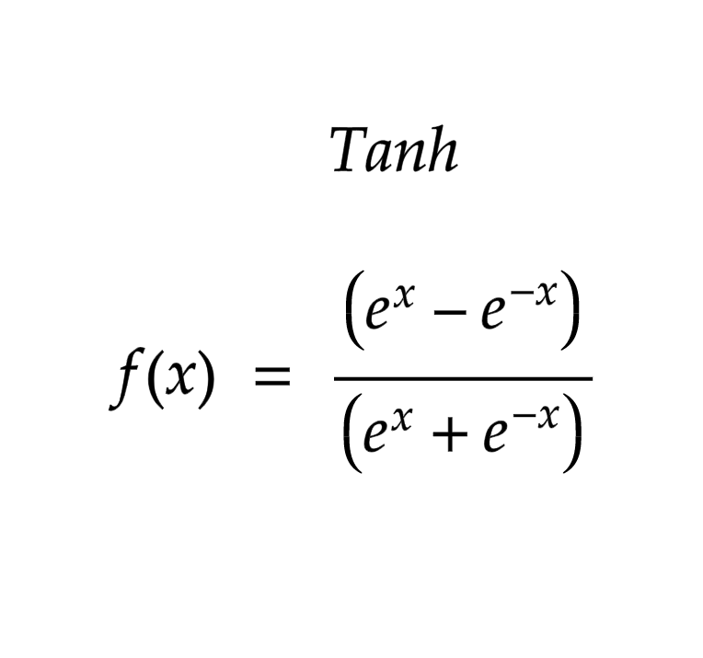
Tanh Function:
The activation function, which is more efficient than the sigmoid function is Tanh function. Tanh function is also known as Tangent Hyperbolic Function. It is a mathematical updated version of the sigmoid function. Sigmoid and Tanh function are similar to each other and can be derived from each other.
F(x)= tanh(x) = 2/(1+e^{-2X}) - 1
OR
Tanh (x) = 2 * sigmoid(2x) - 1
This function is non-linear, and the value range lies between -1 to +1
The activation that works almost always better than sigmoid function is Tanh function also known as Tangent Hyperbolic function. It’s actually mathematically shifted version of the sigmoid function. Both are similar and can be derived from each other.
Equation :- f(x) = tanh(x) = 2/(1 + e-2x) – 1 OR tanh(x) = 2 * sigmoid(2x) – 1
Value Range :- -1 to +1
Nature :- non-linear
Uses :- Usually used in hidden layers of a neural network as it’s values lies between -1 to 1 hence the mean for the hidden layer comes out be 0 or very close to it, hence helps in centering the data by bringing mean close to 0. This makes learning for the next layer much easier.

Slide 29
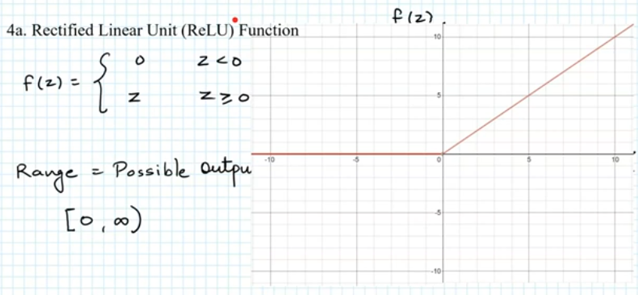
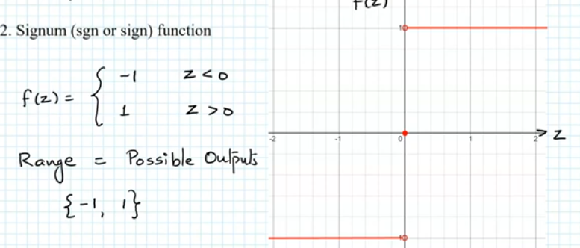
It Stands for Rectified linear unit. It is the most widely used activation function. Chiefly implemented in hidden layers of Neural network.
Equation :- A(x) = max(0,x). It gives an output x if x is positive and 0 otherwise.
Value Range :- [0, inf)
Nature :- non-linear, which means we can easily backpropagate the errors and have multiple layers of neurons being activated by the ReLU function.
Uses :- ReLu is less computationally expensive than tanh and sigmoid because it involves simpler mathematical operations. At a time only a few neurons are activated making the network sparse making it efficient and easy for computation.
In simple words, RELU learns much faster than sigmoid and Tanh function.

Slide 30
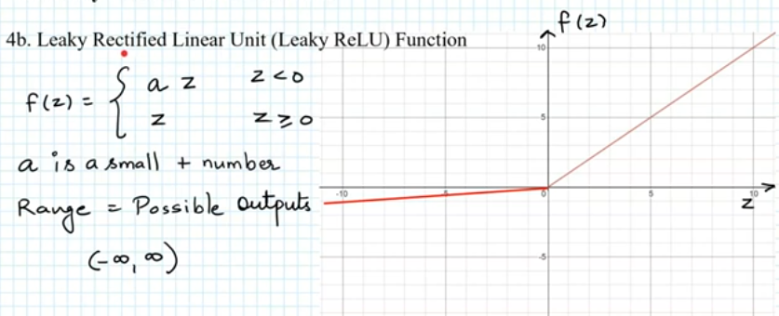
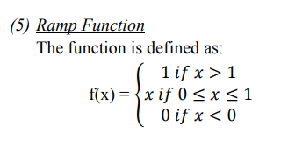
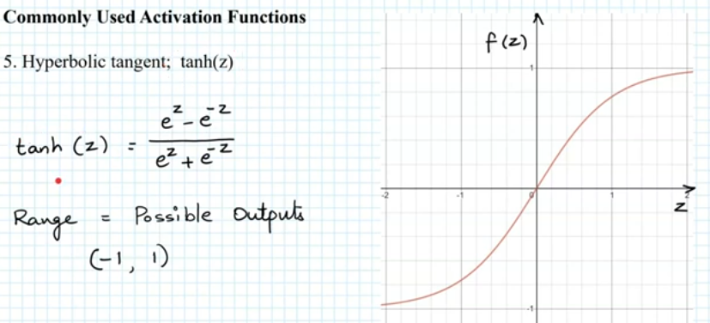

Slide 31
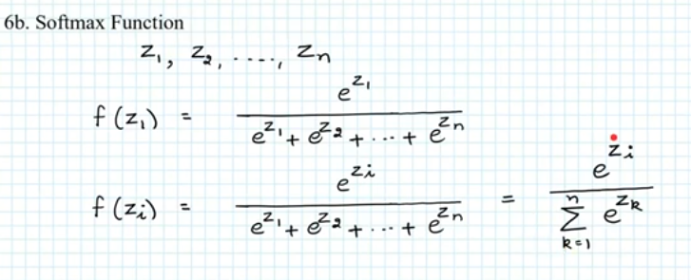
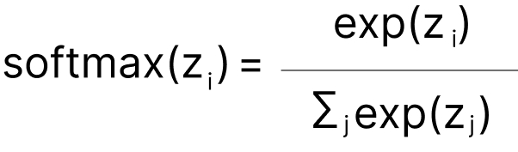
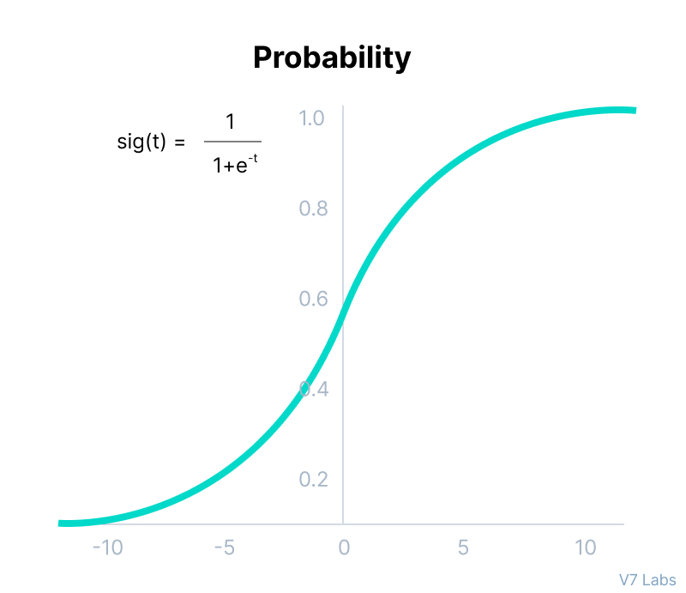
Softmax function calculates the probabilities distribution of the event over ‘n’ different events. In a general way, this function will calculate the probabilities of each target class over all possible target classes. Later the calculated probabilities will help determine the target class for the given inputs.
The softmax function is also a type of sigmoid function but is handy when we are trying to handle multi- class classification problems.
Nature :- non-linear
Uses :- Usually used when trying to handle multiple classes. the softmax function was commonly found in the output layer of image classification problems.The softmax function would squeeze the outputs for each class between 0 and 1 and would also divide by the sum of the outputs.
Output:- The softmax function is ideally used in the output layer of the classifier where we are actually trying to attain the probabilities to define the class of each input.
The basic rule of thumb is if you really don’t know what activation function to use, then simply use RELU as it is a general activation function in hidden layers and is used in most cases these days.
If your output is for binary classification then, sigmoid function is very natural choice for output layer.
If your output is for multi-class classification then, Softmax is very useful to predict the probabilities of each classes.
Used frequently when managing several classes. In the output nodes of image classification issues, the softmax was typically present. The softmax function would split by the sum of the outputs and squeeze all outputs for each category between 0 and 1.

Slide 32
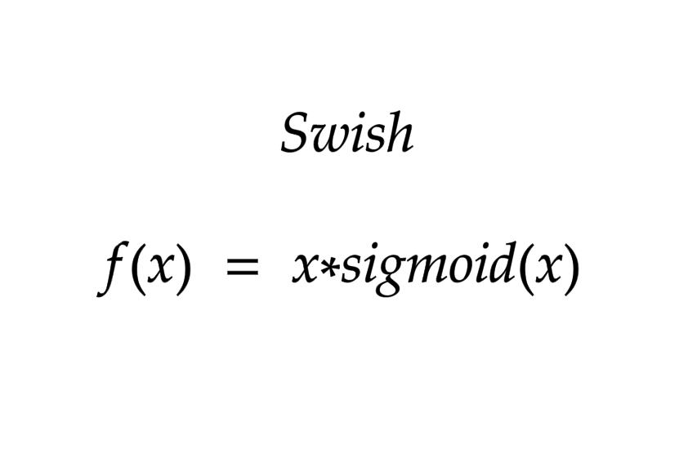
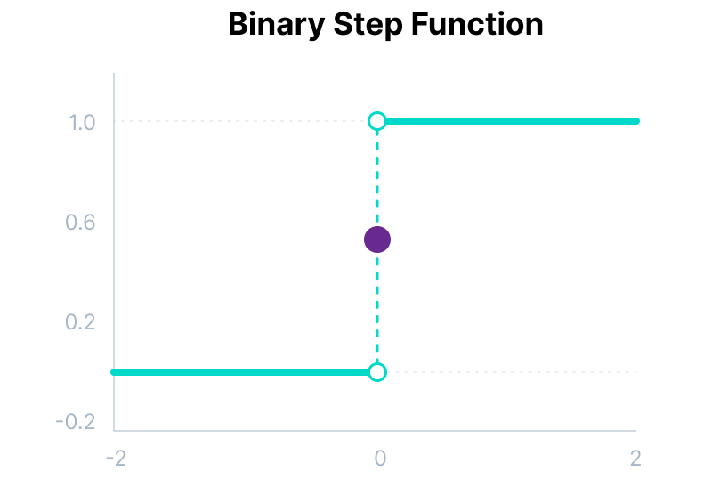
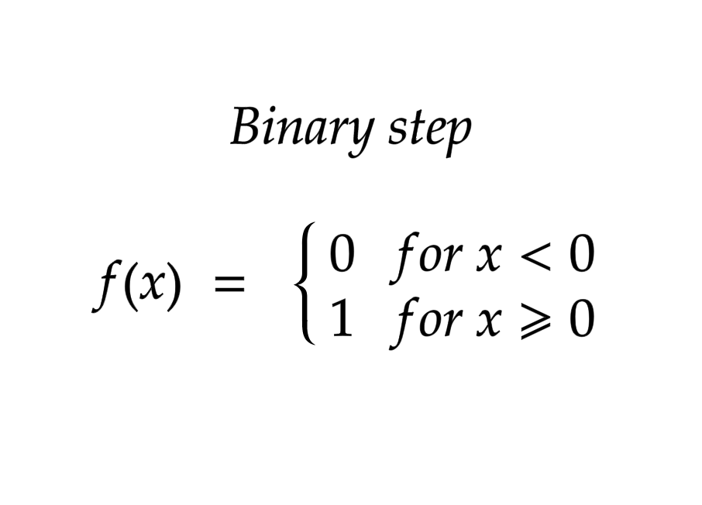
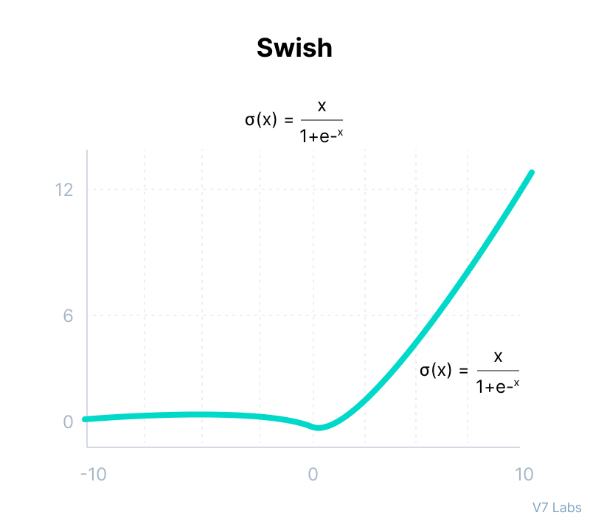
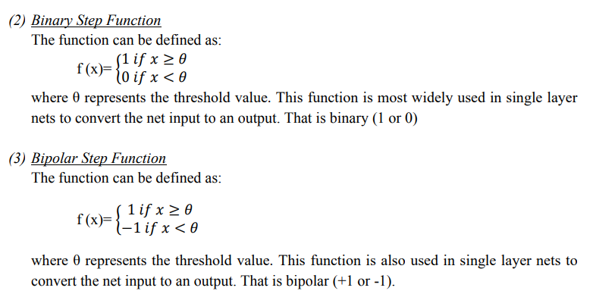

Slide 33
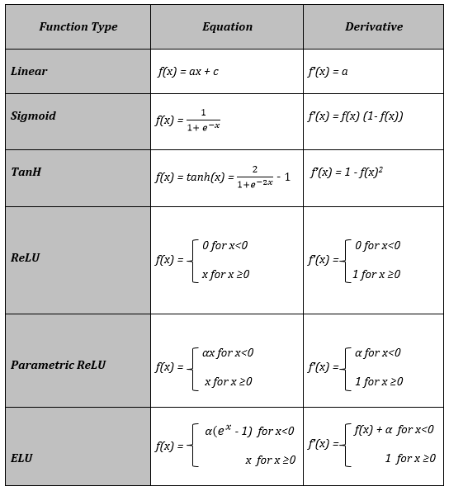

Slide 34
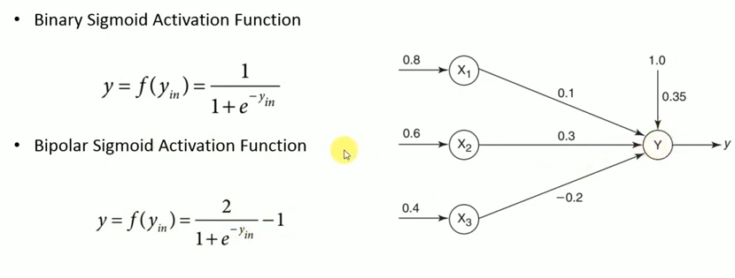
Obtain the output of the neuron Y using
Binary sigmoidal and
Bipolar sigmoidal activation function

Slide 35
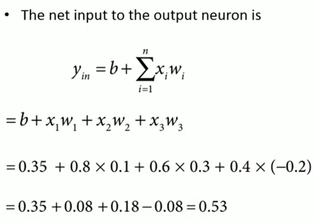
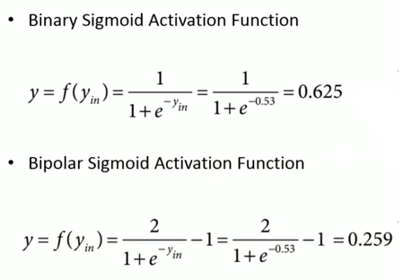

Slide 36




